Slide 1

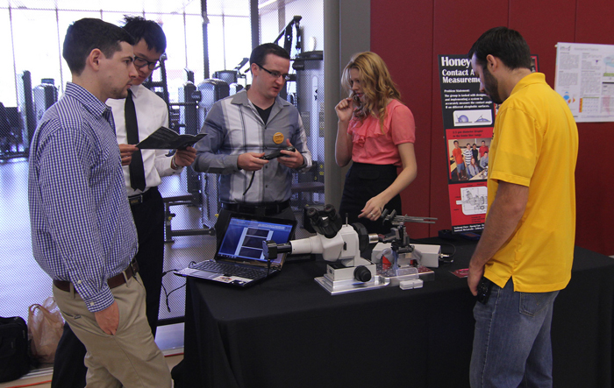
Team
“John Steinbeck”

Slide 2
Tanya Petkova – tanya
Diana Pesheva – dpesheva
Rumen Rumenov – rumen.rumen
Petar Petrov – petur_petrov
Qnko Vanov - iankovanov
Stanislav Valkov - smvalkov
Team members

Slide 3
Goals
To create a WF game
To include several levels
To implement movement controlled by the player
To implement movement controlled by the computer
To practice some OOP

Slide 4
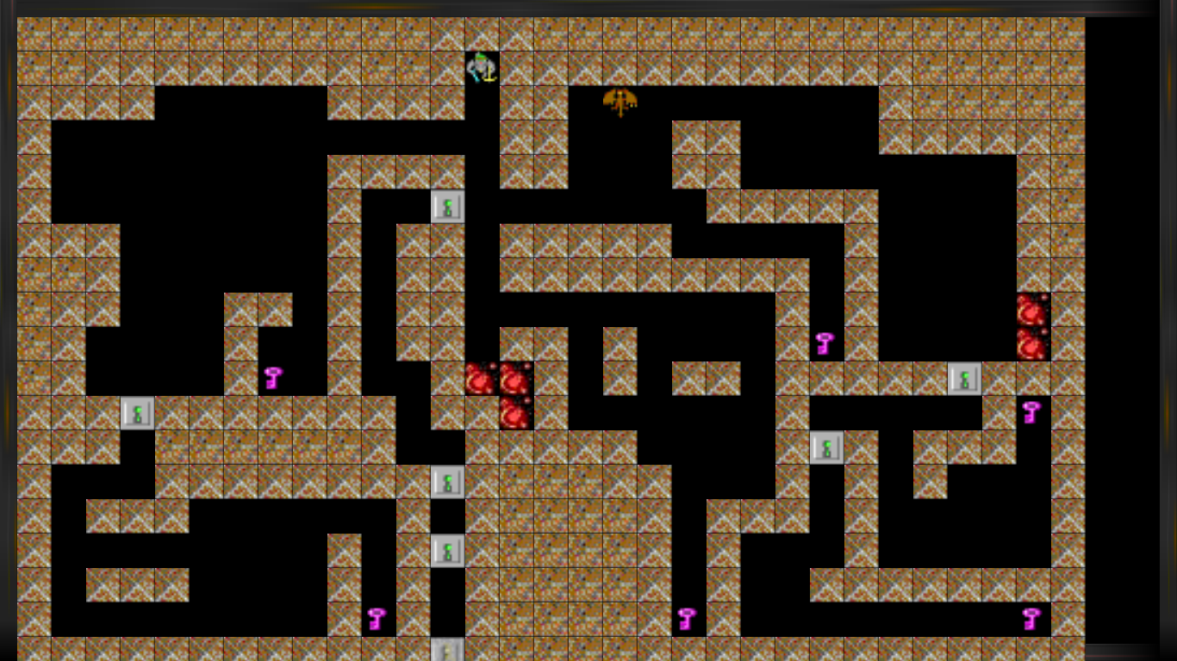
Project: Dark Dungeon
Collect keys and reach the Exit while a bad guy is after you!
You need to collect all keys for the locked doors to pass the level!

Slide 5
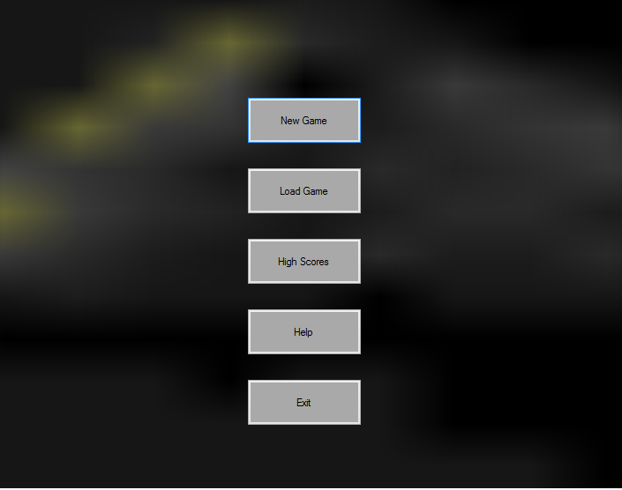
Project: Dark Dungeon
You are curious about the GAME!
Just start it and go to the main screen, where the adventure begins.

Slide 6
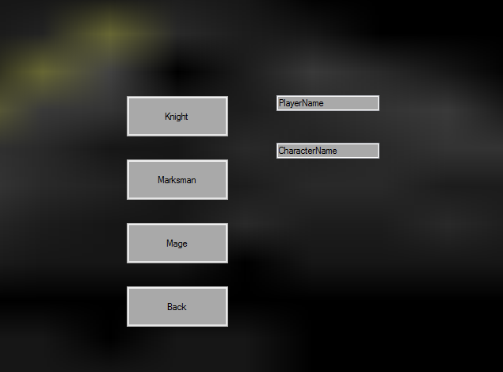
Project: Dark Dungeon
Tired of play the same character hero over and over again?
We have implement a variety of tree different characters with their own complexity.

Slide 7
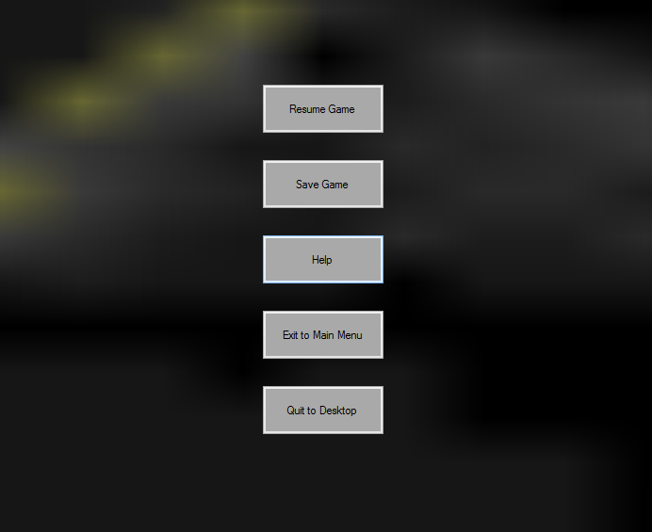
Project: Dark Dungeon
You don’t want to play anymore?
/hard to believe/
Press esc and use the mouse to make your choice!

Slide 8

Realization
All requirements about this project are fulfilled :
Interfaces count – 8
Classes count – 35
Abstract classes – 4
Enumeration count - 2
Depth in inheritance – 3 levels
Etc.

Slide 9
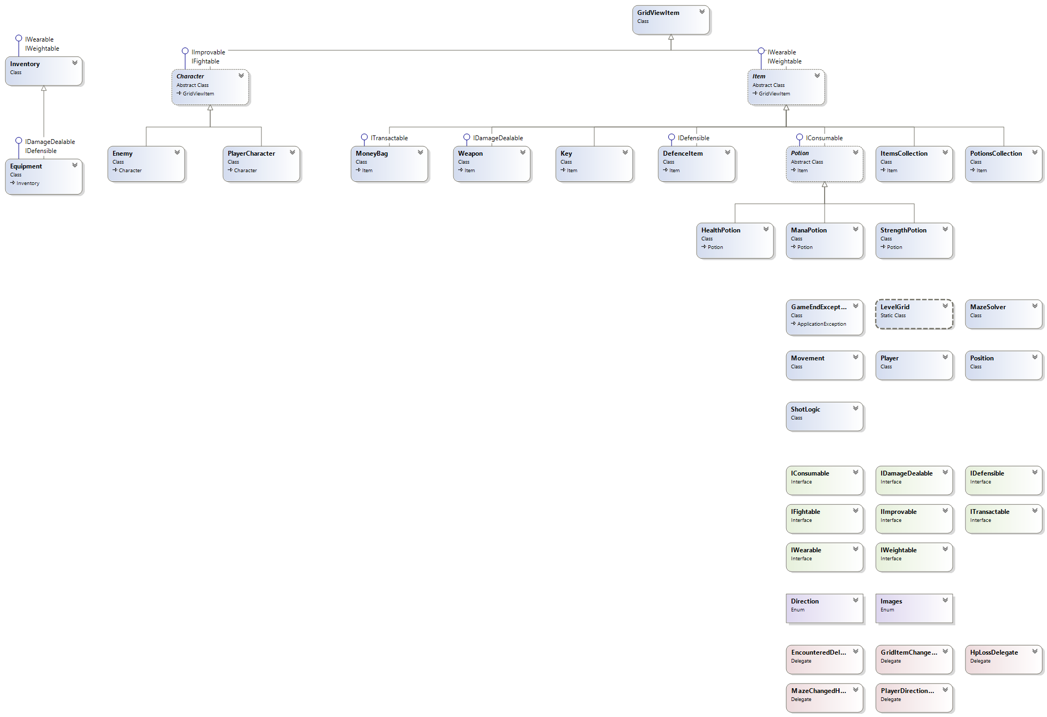
Realization
Dark Dungeon Data Class Diagram

Slide 10
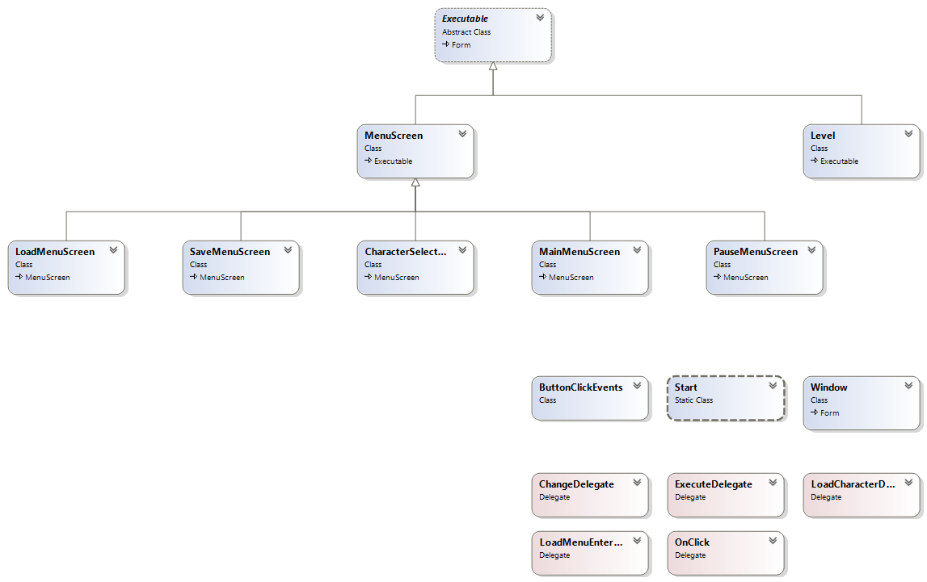
Realization
Dark Dungeon GUI Class Diagram

Slide 11

Great contribution
from everybody
We learned a lot from each other…
and had a lot of fun

Slide 12
Thank you for your attention!

